Slide 1
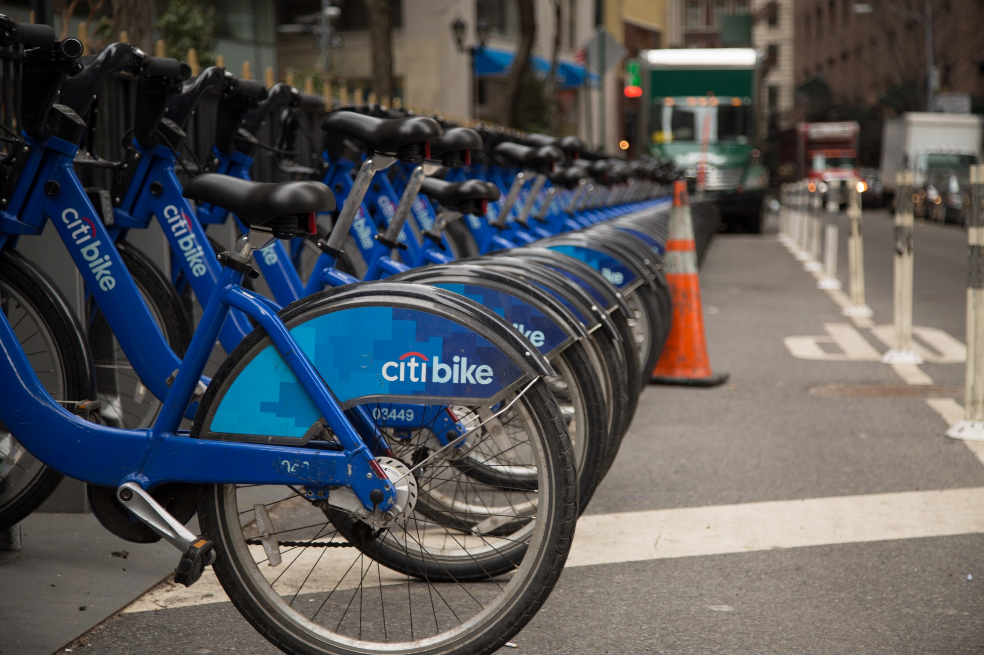

Data Science Project- Citibike
Presented by-
Varun Ramesh (vr2121@nyu.edu)
Jonathan Kung (hk3234@nyu.edu)
Rajan Shantanu Chaturvedi (rsc9044@nyu.edu)

Slide 2
TABLE OF CONTENTS
1. Business problems
2. Technical setup
3. Results
4. Challenges and Changes
5. Deployment/ Next Steps
6. Limitations/ Other Work

Slide 3
Business problems
Problem Statement-
We want to predict the number of trips that will originate at Citibike stations located near either Grand Central Station or near Penn Station, with the time period before midnight on the day of interest.
Current Solution-
Citibike uses machine learning algorithms to help optimize the time of their operations team so that they can be more efficient in moving bikes across stations. They have also implemented Valet Service for expanded bike and dock availability. The company also rewards their customers with points which are redeemable.
Source- https://ride.citibikenyc.com/blog/ridershiprecords

Slide 4
Our Solution-
We will be using Decision Tree Classifier Algorithm for our prediction for the 2019 dataset. We use this because the algorithm needs low level of data preparation which is very much needed in this case, and it will be able to distinguish a large number of classes with less error. The maximum tree depth is set at 9.
We will be using K nearest neighbor (KNN) for our prediction for the 2021 dataset since it is versatile to different calculations of proximity. It is also a memory-based approach.

Slide 5
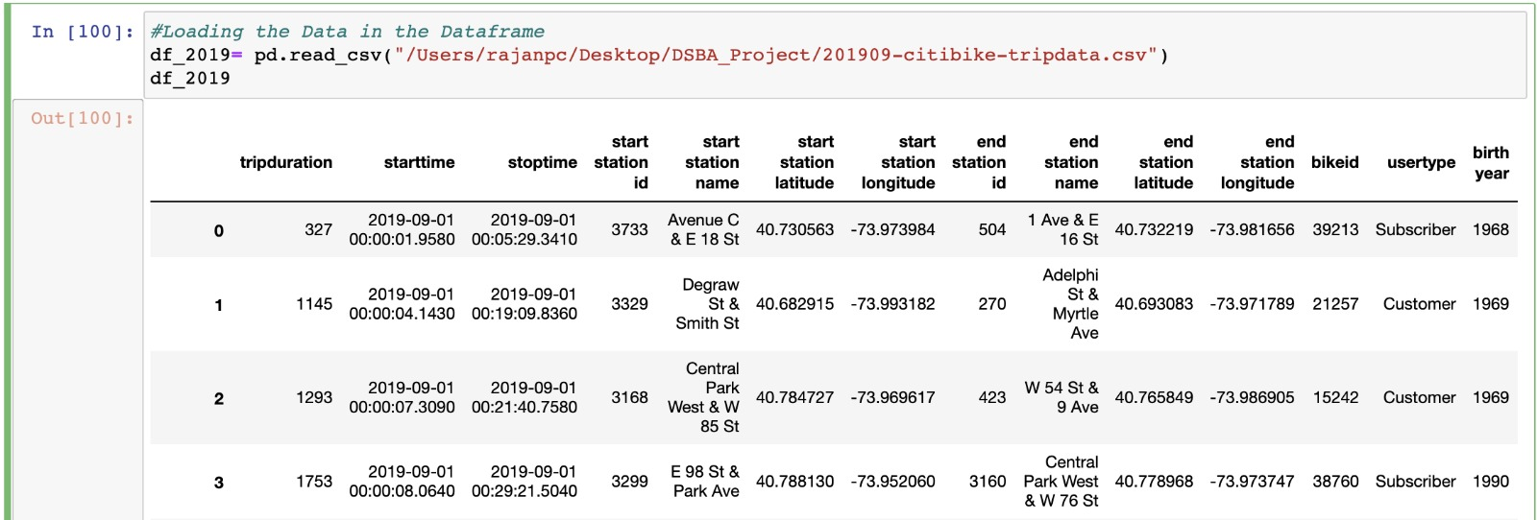
Technical setup
Data Understanding- The data provided is that of 2019 and 2021 which contains all citibike trips made in September. A weather dataset is also provided which contains the weather information from the year 2018 to 2021 of NYC. 2019 Dataset

Slide 6
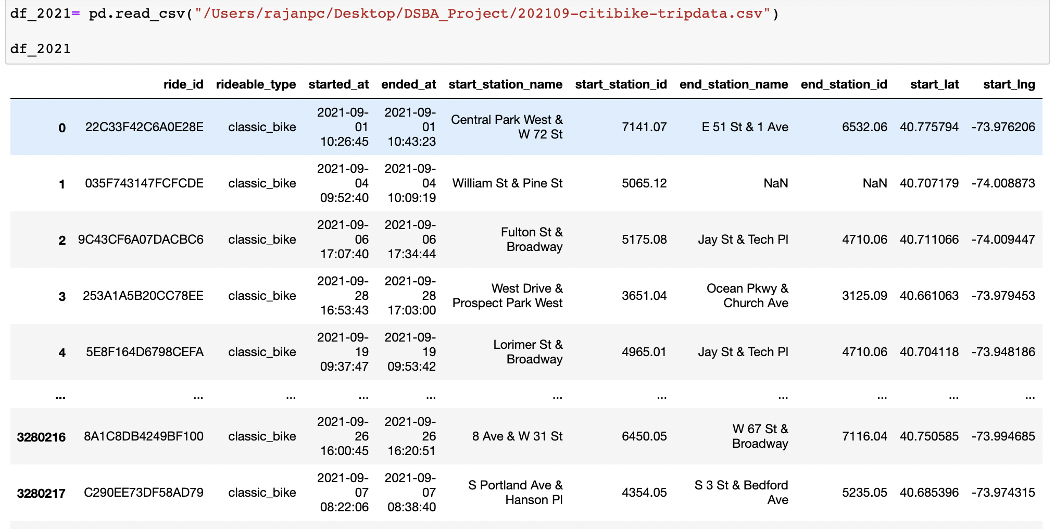
2021 Dataset:

Slide 7
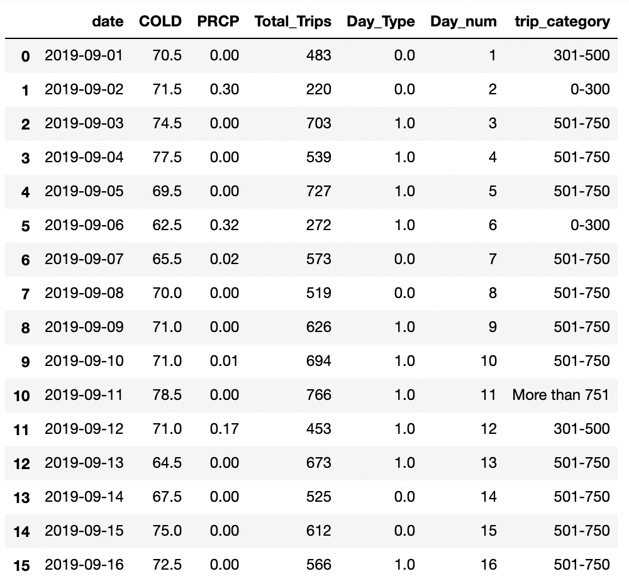
Weather Dataset-

Slide 8
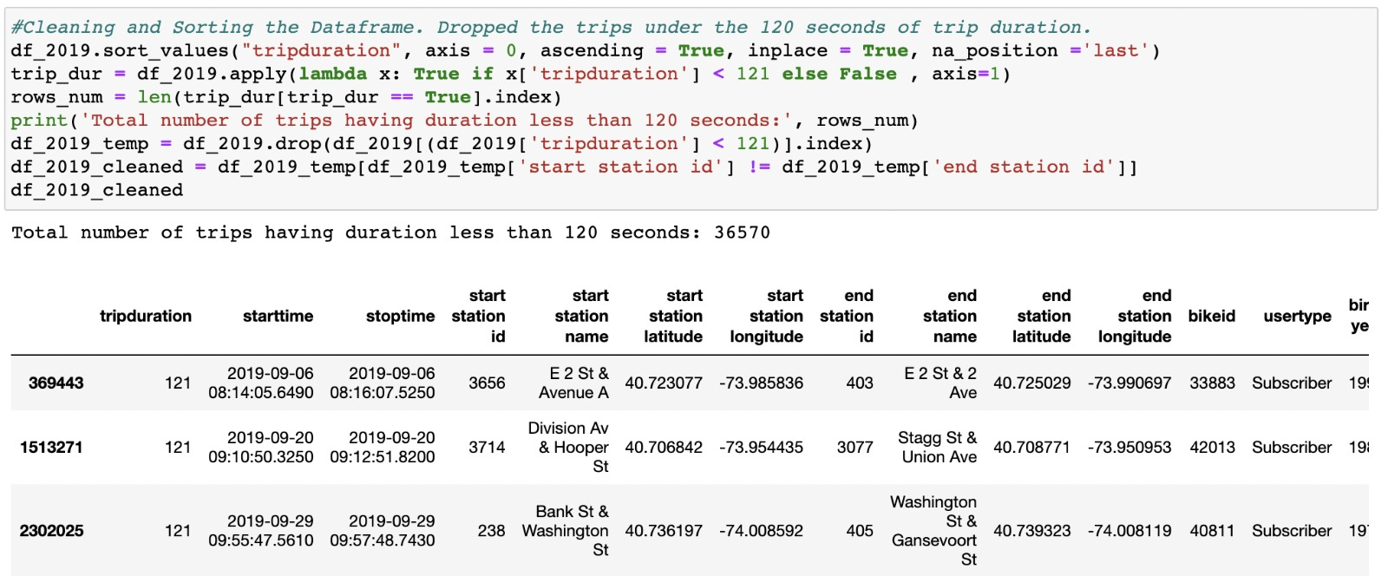
Data Preparation- First, we filter out the trips whose duration was less than 120 seconds or 2 minutes. Then we drop the rows which have the same start and end station. In the next step we calculate whether a given day is a weekday or a weekend and whether it is a holiday or not. New columns are created containing both these values. Cold and precipitation columns are also added in the final data preparation.
2019 Cleaned Dataset -

Slide 9
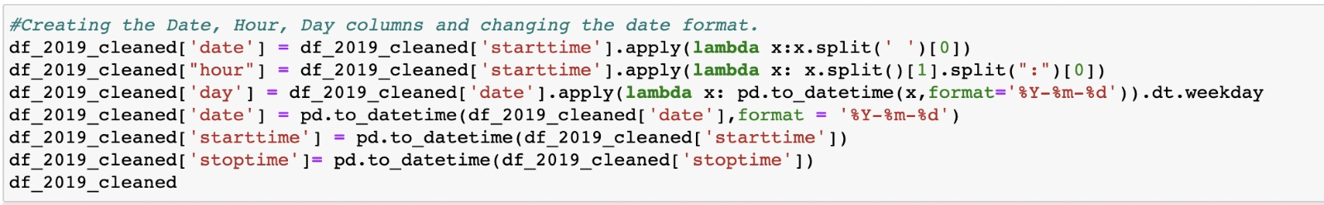
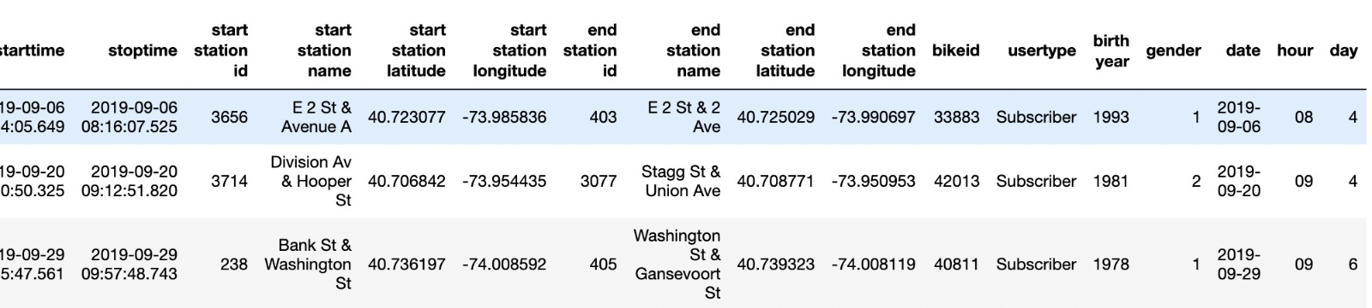

Slide 10
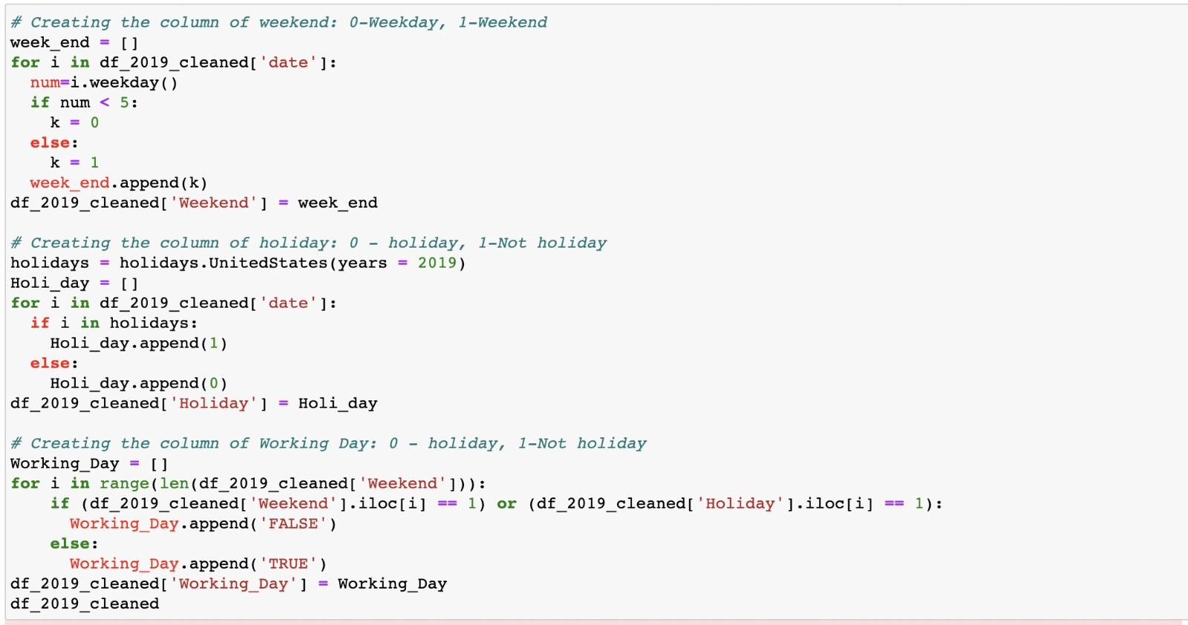
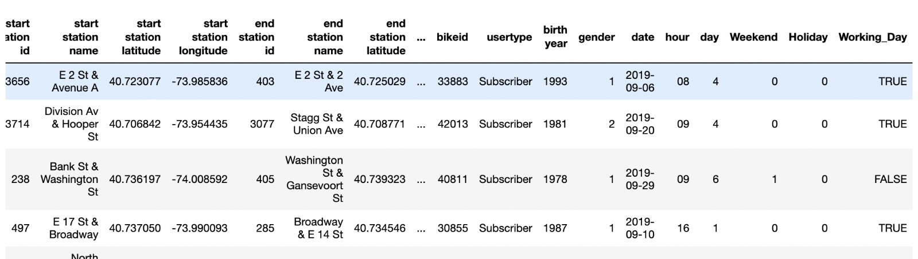

Slide 11
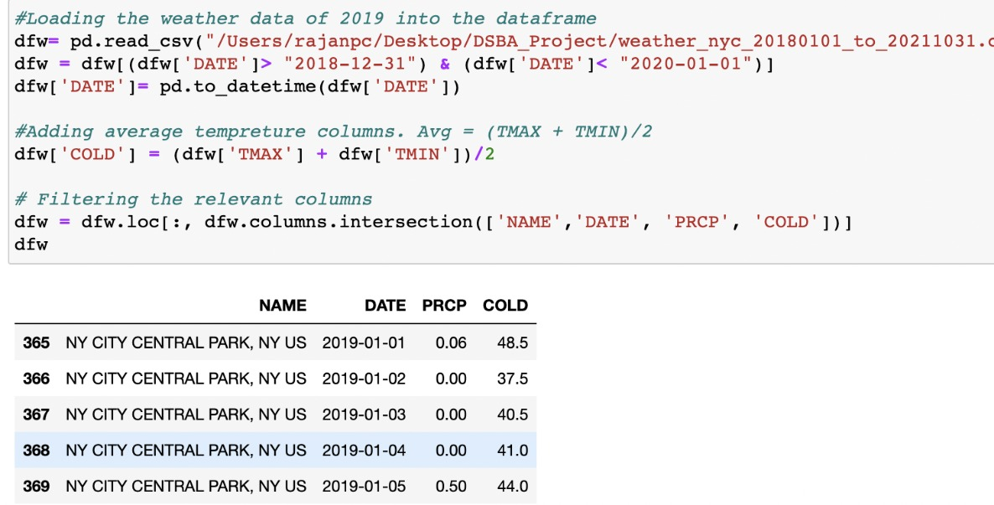

Slide 12
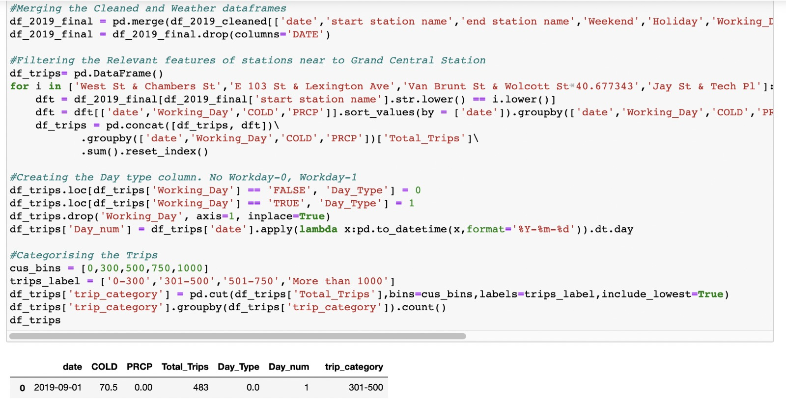

Slide 13
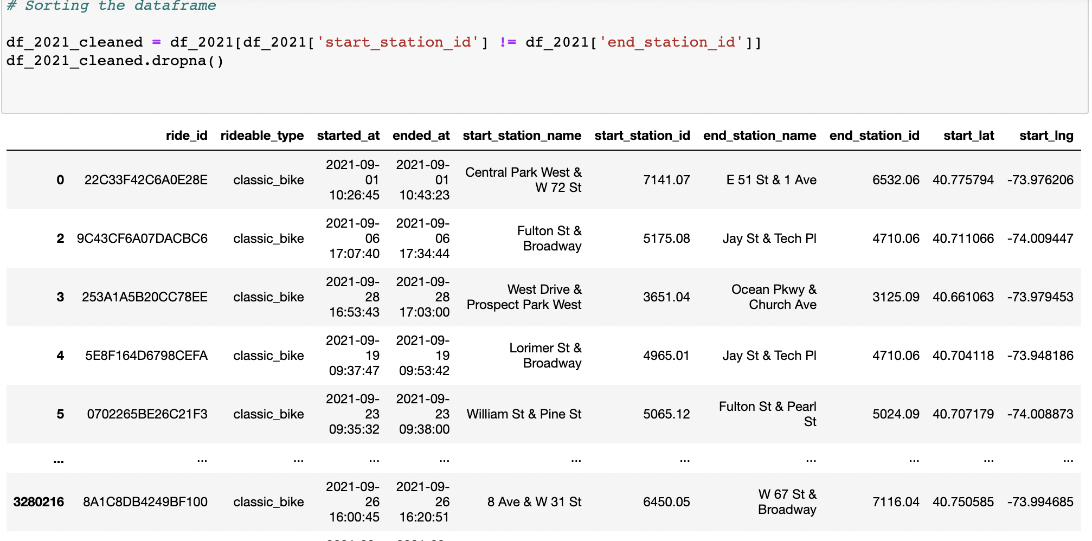
2021 Cleaned Dataset-

Slide 14
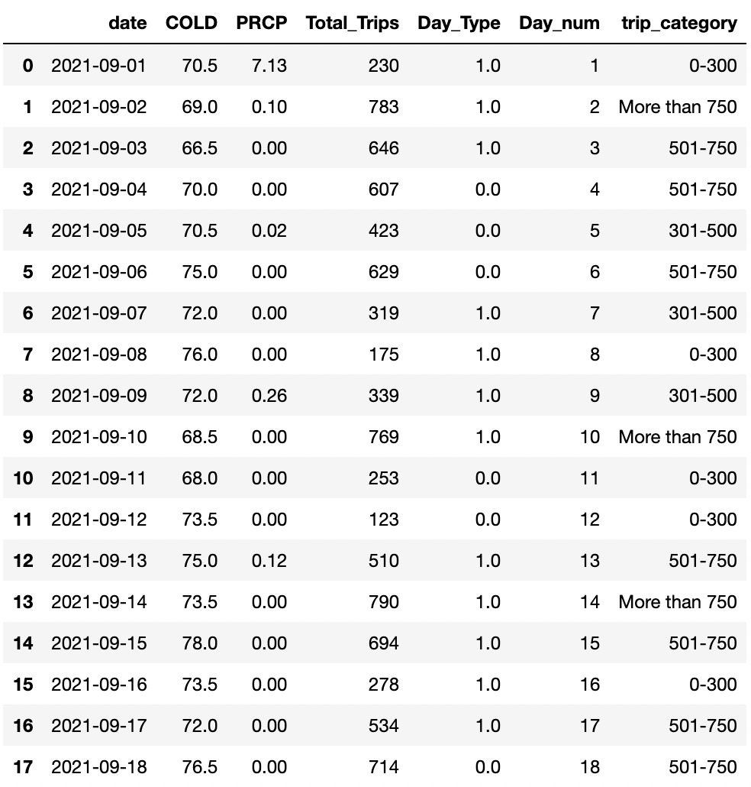
Using the same method mentioned in the
above slides, the final 2021 dataset is
obtained.

Slide 15
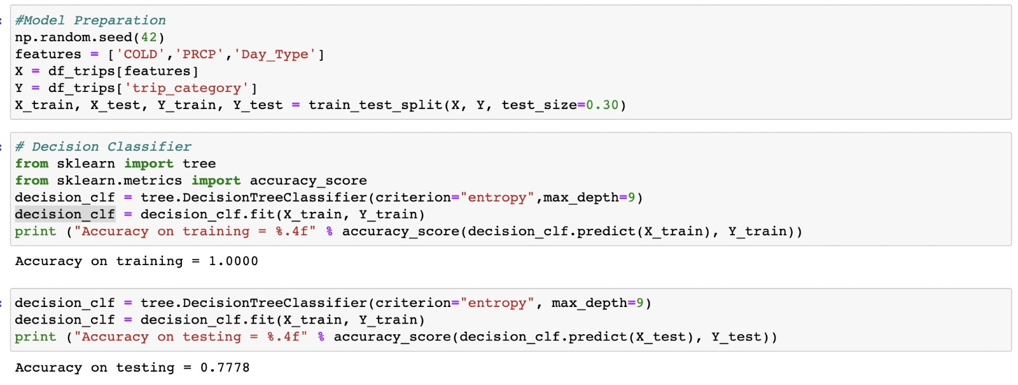
Modeling Techniques- We are going to use Decision Tree Classifier and K Nearest Neighbor for our problem. In the DT classifier we split the data into 70% training and 30% testing data with max depth 9. For KNN we split the data into 65% training and 35% testing data with n neighbors=3.
Performance Measures- We will be using accuracy score and confusion matrix as performance measures.

Slide 16
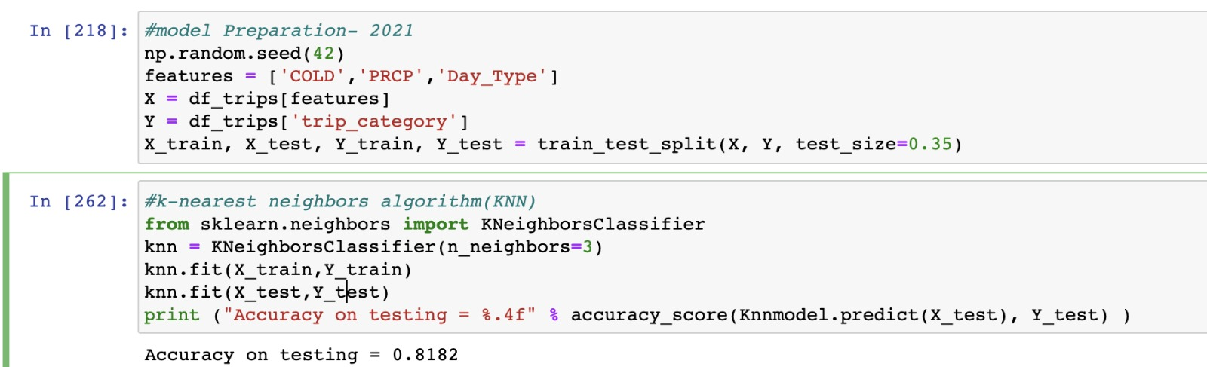

Slide 17
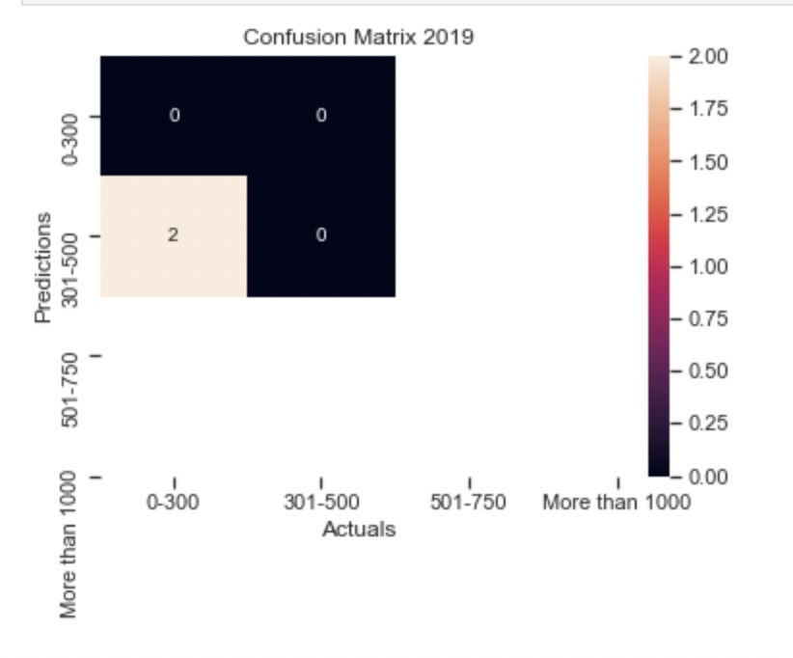
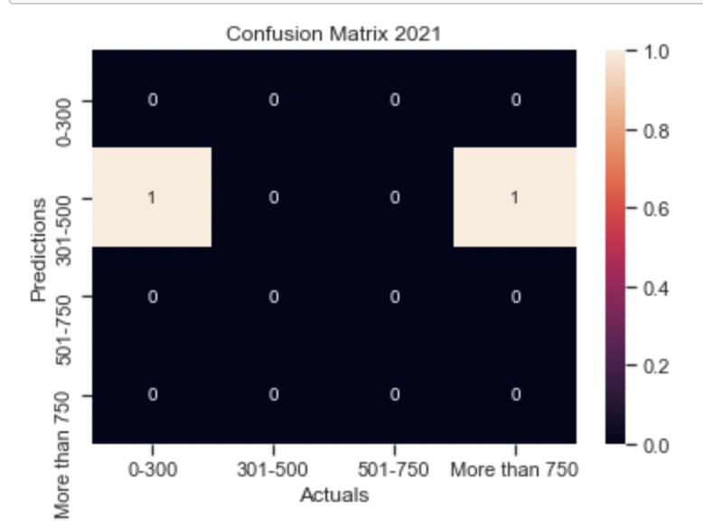

Slide 18
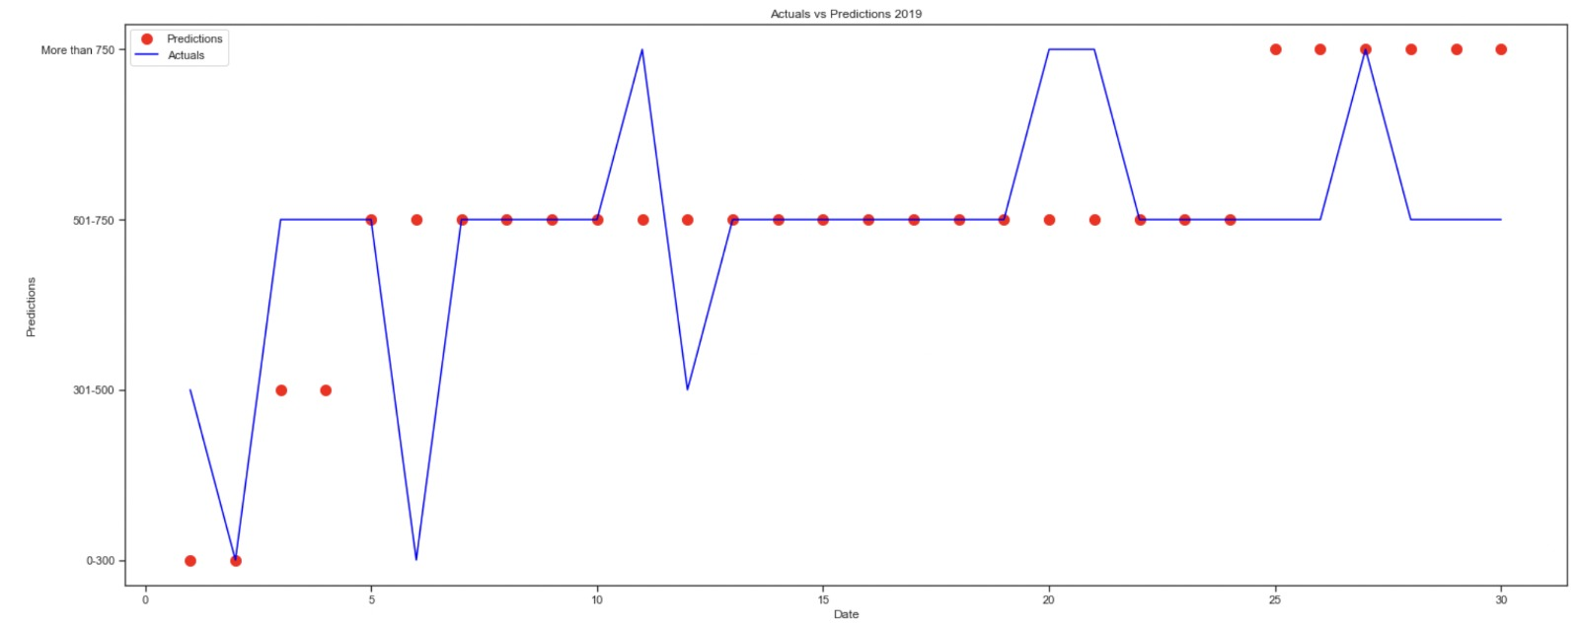
Results

Slide 19
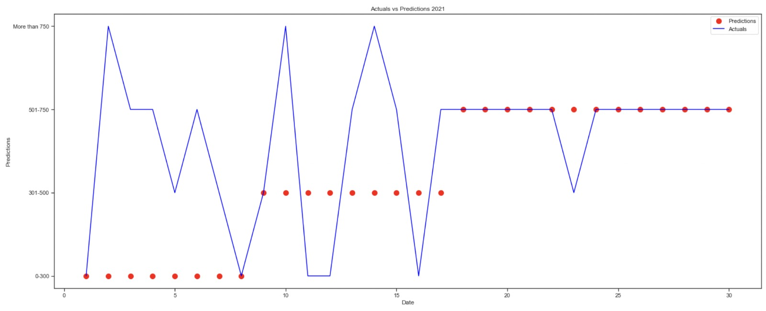

Slide 20
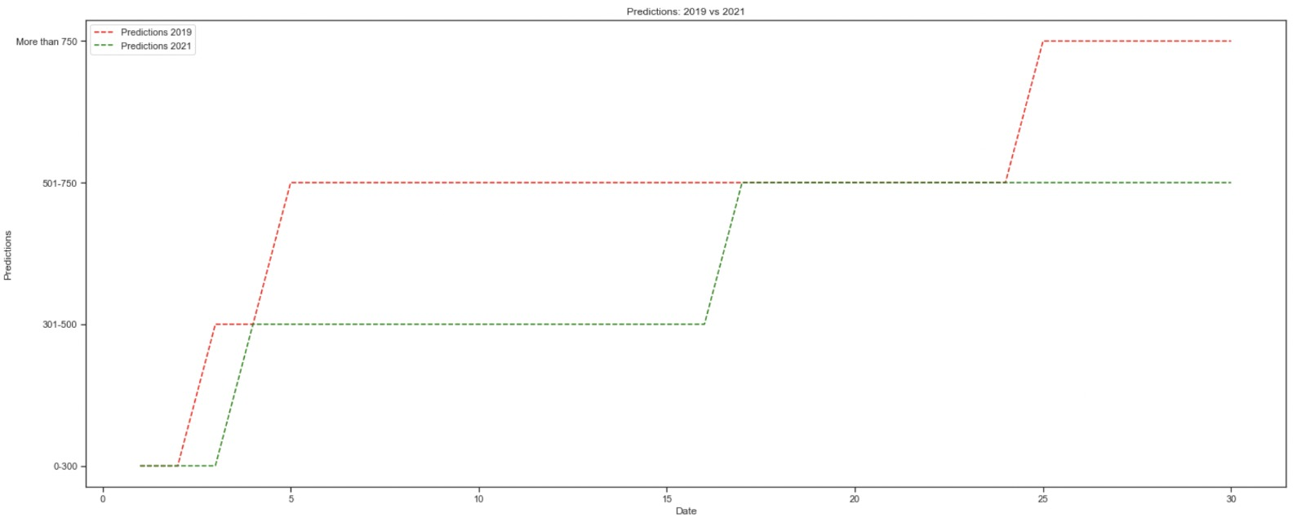

Slide 21
Technical Challenges and Changes
We used two different algorithms on both the datasets because using Decision Tree Algorithm on the 2021 dataset only resulted in a 40% accuracy rate. We tried to debug the code, but we didn’t have enough time. This is the reason we used KNN for the 2021 dataset.
We would probably use all the algorithms for prediction and choose the most fitting algorithm. We would use the same algorithm for both the datasets.
We would also have a better prediction if both the datasets had similar columns and structure.

Slide 22
Deployment/ Next Steps
If the results were successful, we would like to predict the number of rides for the whole year. This will provide a better insight into customer behaviors, patterns, etc.
With a successful code, Citi can predict customer patterns which will be in the next month. Keeping this in consideration they can release related advertisement campaigns, promos, etc.

Slide 23
Limitation/ Other Work
1. If there were bike types in both the datasets, Citi could have potentially identified which of their bike types are used the most and those bike types could have been deployed in its stations.
2. There were lot of ‘NA’ values in the dataset. These values severely affect the prediction.
3. In the dataset, a member is only listed as a member whereas there are three types of membership in citibike namely monthly, yearly and daily passes. A more detailed database is needed for detailed predictions.
4. We have filtered stations which have the same names. This will also filter out the customers who actually ride for a long time and end up at the same station.

